Slide 1
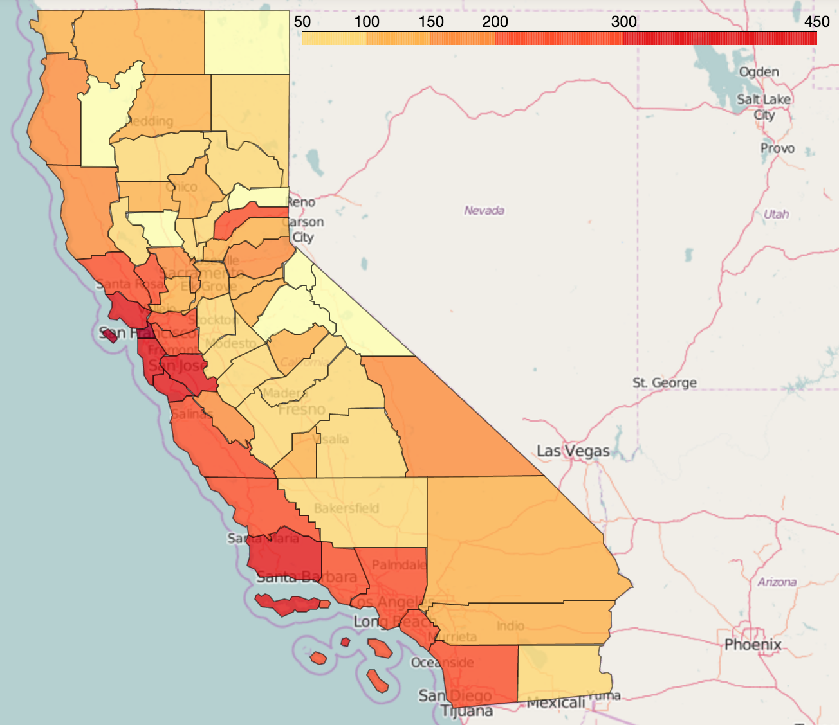
Impact of Community Indicators on Real Estate Value
DS-SF-24 Final Project
Chris Salviati
August 18, 2016

Slide 2
DS-SF-24 Final Project
C. Salviati
BACKGROUND

Slide 3

DS-SF-24 Final Project
C. Salviati
Sources
California Healthy Communities Indicators
“The goal of HCI is to enhance public health by providing data, a standardized set of statistical measures, and tools that a broad array of sectors can use for planning healthy communities and evaluating the impact of plans, projects, policy, and environmental changes on community health”
E.g. Poverty/Unemployment Rates, Access to Parks/Public Transit
Data for most cities/towns in California at different levels of geographic specificity

Slide 4

DS-SF-24 Final Project
C. Salviati
Sources
Zillow Data
“Zillow is the leading real estate and rental marketplace dedicated to empowering consumers with data, inspiration and knowledge around the place they call home, and connecting them with the best local professionals who can help”
Provides time series data for a wide variety of real estate value and rental price metrics
Nationwide data at different levels of geographic specificity

Slide 5
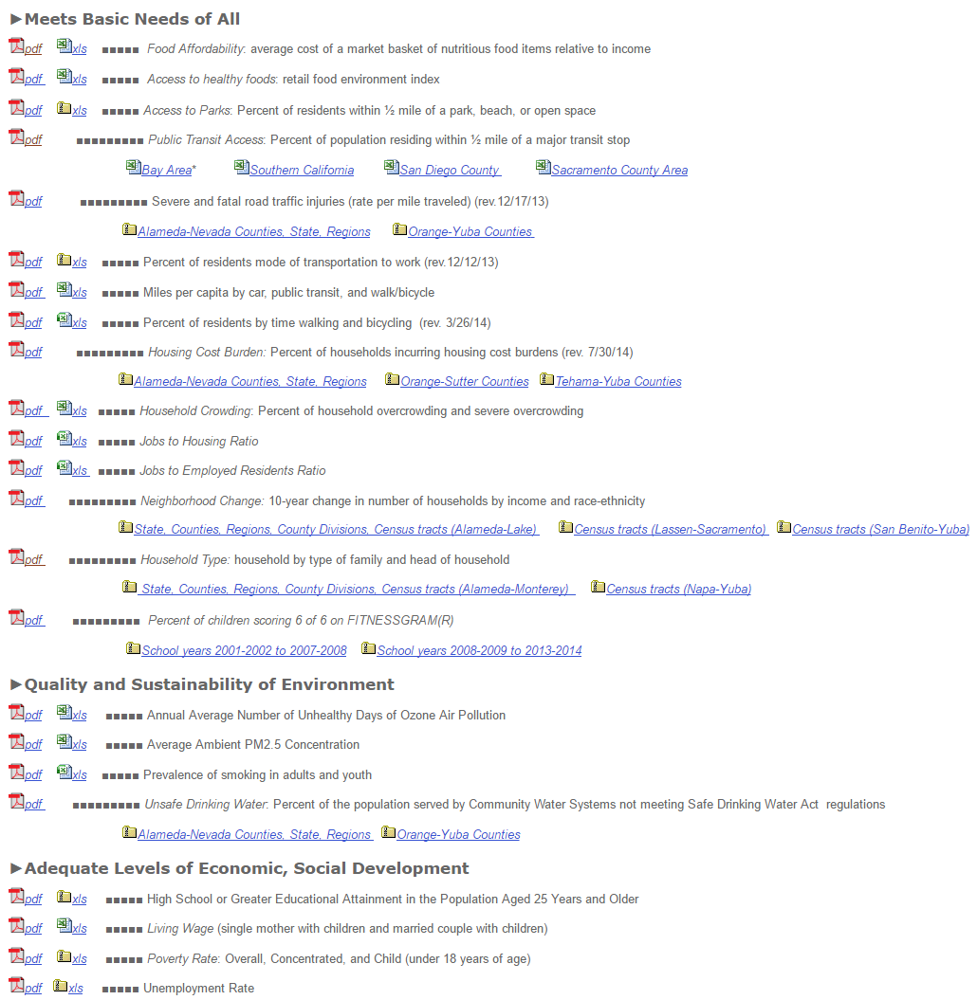
DS-SF-24 Final Project
C. Salviati
Cleaning
Building HCI Data
Each indicator kept in a separate file
Differences in reporting year, geographic level
Format – needed to reshape some data
Merging with Zillow Data
Merged on city/town name and county
Hand clean discrepancies (e.g. spelling, county)
Missing Data
Filled in using regression imputation plus error
Final cleaned dataset: 710 observations

Slide 6
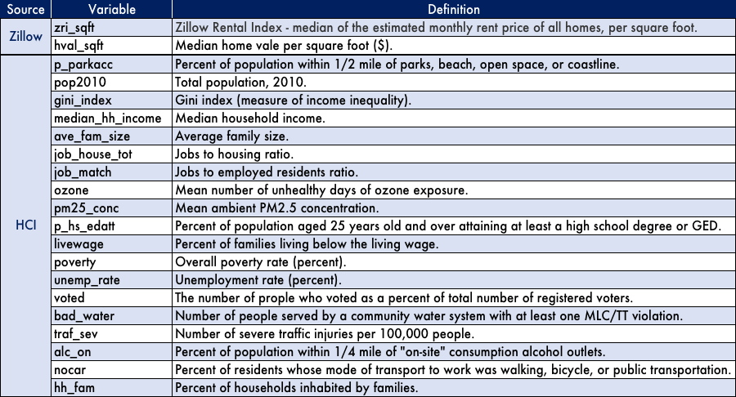
DS-SF-24 Final Project
C. Salviati
Data Dictionary

Slide 7
DS-SF-24 Final Project
C. Salviati
Goals
Interpretation
Which of these community indicators have a positive/negative impact on housing prices? Which are the best predictors?
Hypothesis
Positive Impact: median_hh_income, p_parkacc, alc_on, nocar, p_hs_edatt
Negative Impact: poverty, unemp_rate, bad_water
Visualization
Use maps to help tell the stories implied by the models

Slide 8
DS-SF-24 Final Project
C. Salviati
MODELS

Slide 9
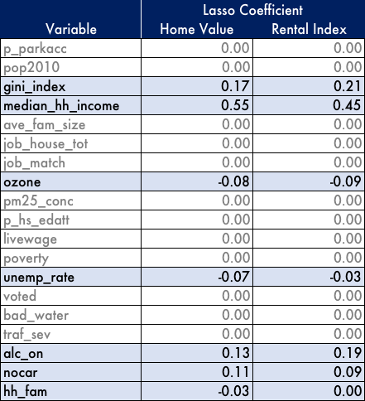
DS-SF-24 Final Project
C. Salviati
Lasso
Identify Relevant Predictors
Databuild contains 19 HCI variables
Use Lasso to identify which are most important
Tune alpha using cross-validation (0.1)
Results
More than half of the indicators are excluded from the model
Similar results for each dependent variable (home value or rental index)

Slide 10
DS-SF-24 Final Project
C. Salviati
Linear Regression
Start with Variables Identified by Lasso
gini_index, median_hh_income, ozone, unempt_rate, alc_on, nocar, hh_fam
Drop Additional Variables based on Correlation
hh_fam (strong negative correlation with gini_index and nocar)
unemp_rate (strong negative correlation with median_hh_income)
alc_on (strong positive correlation with nocar)

Slide 11
DS-SF-24 Final Project
C. Salviati
Linear Regression
Results
Original:
Log-Tranformed:

Slide 12
DS-SF-24 Final Project
C. Salviati
Linear Regression
Gini Index – Possible Explanation
Housing cost and HH income variables measure medians
When income is skewed, rich residents tend to move median housing costs upward
No corresponding downward pressure from poor residents (spend proportionally more on housing)

Slide 13
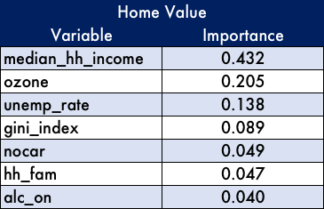
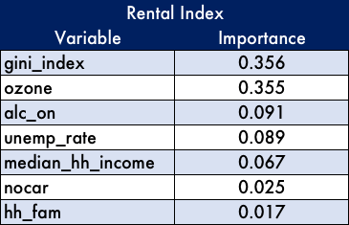
DS-SF-24 Final Project
C. Salviati
Decision Tree
Results – Variables Identified by Lasso
*Tuned separately for maximum terminal nodes

Slide 14
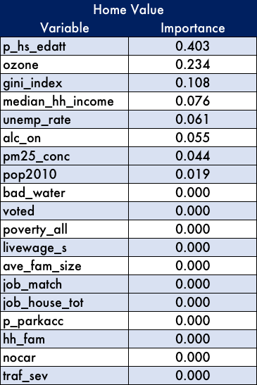
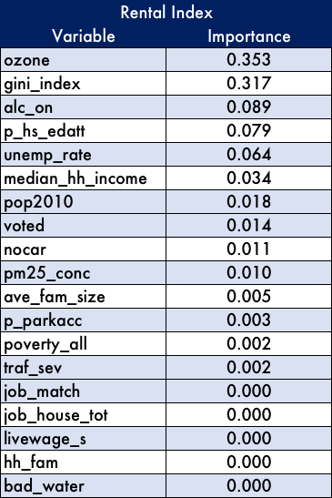
DS-SF-24 Final Project
C. Salviati
Decision Tree
Results –
All Variables
*Tuned separately for
maximum terminal nodes

Slide 15
DS-SF-24 Final Project
C. Salviati
MAPS

Slide 16
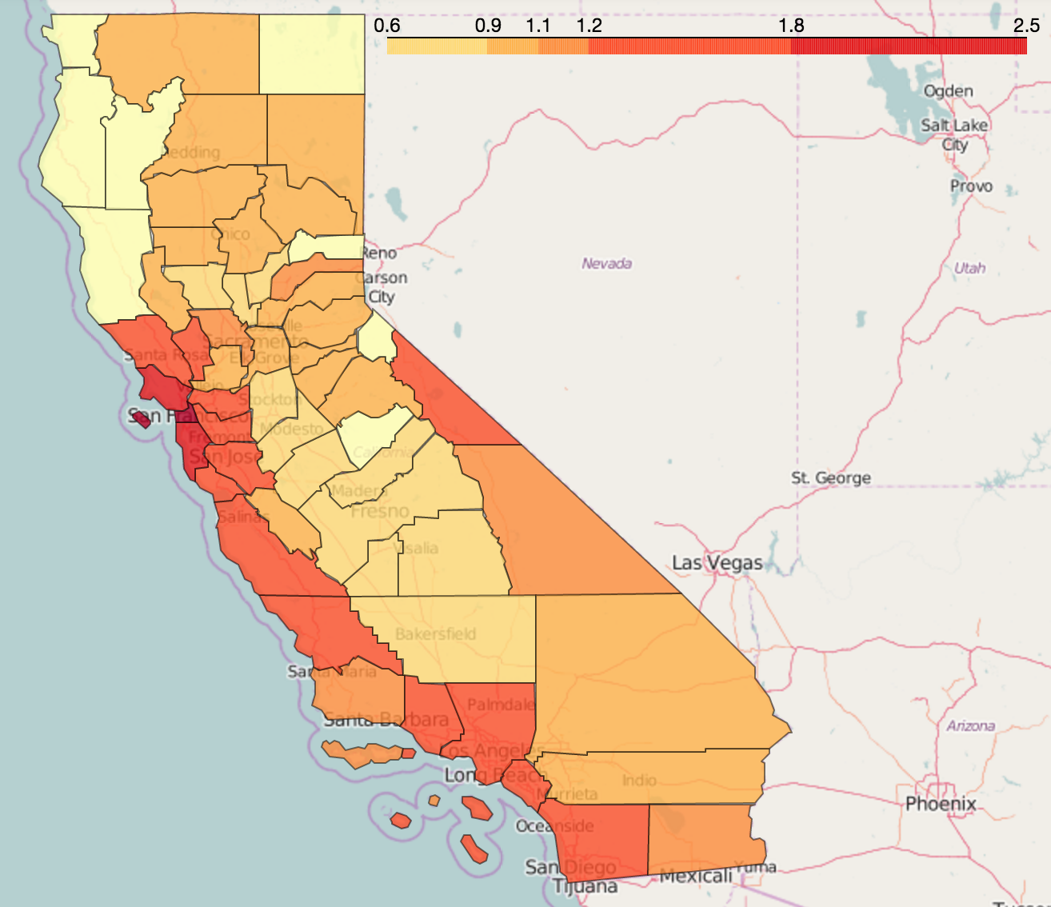
DS-SF-24 Final Project
C. Salviati
Home Value Per Sqft.
Rental Price Per Sqft.

Slide 17
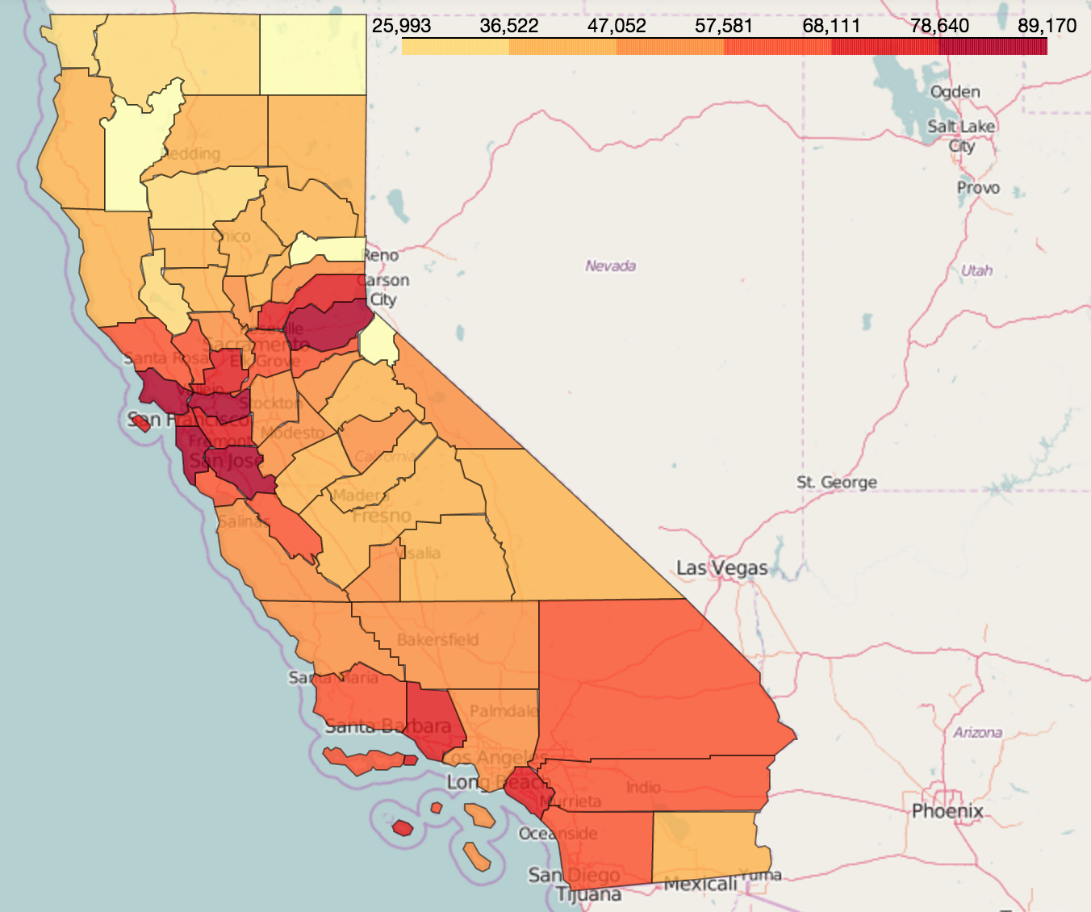
DS-SF-24 Final Project
C. Salviati
Median Household Income
Home Value
Rental Price

Slide 18
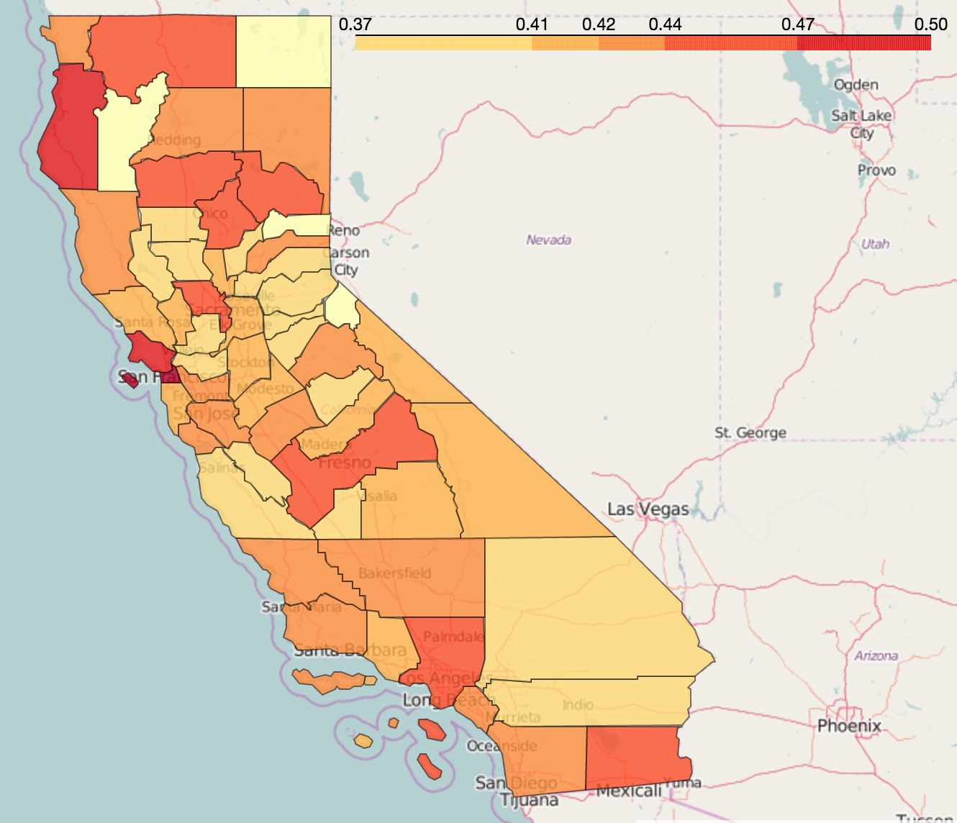
DS-SF-24 Final Project
C. Salviati
Gini Index
Home Value
Rental Price

Slide 19
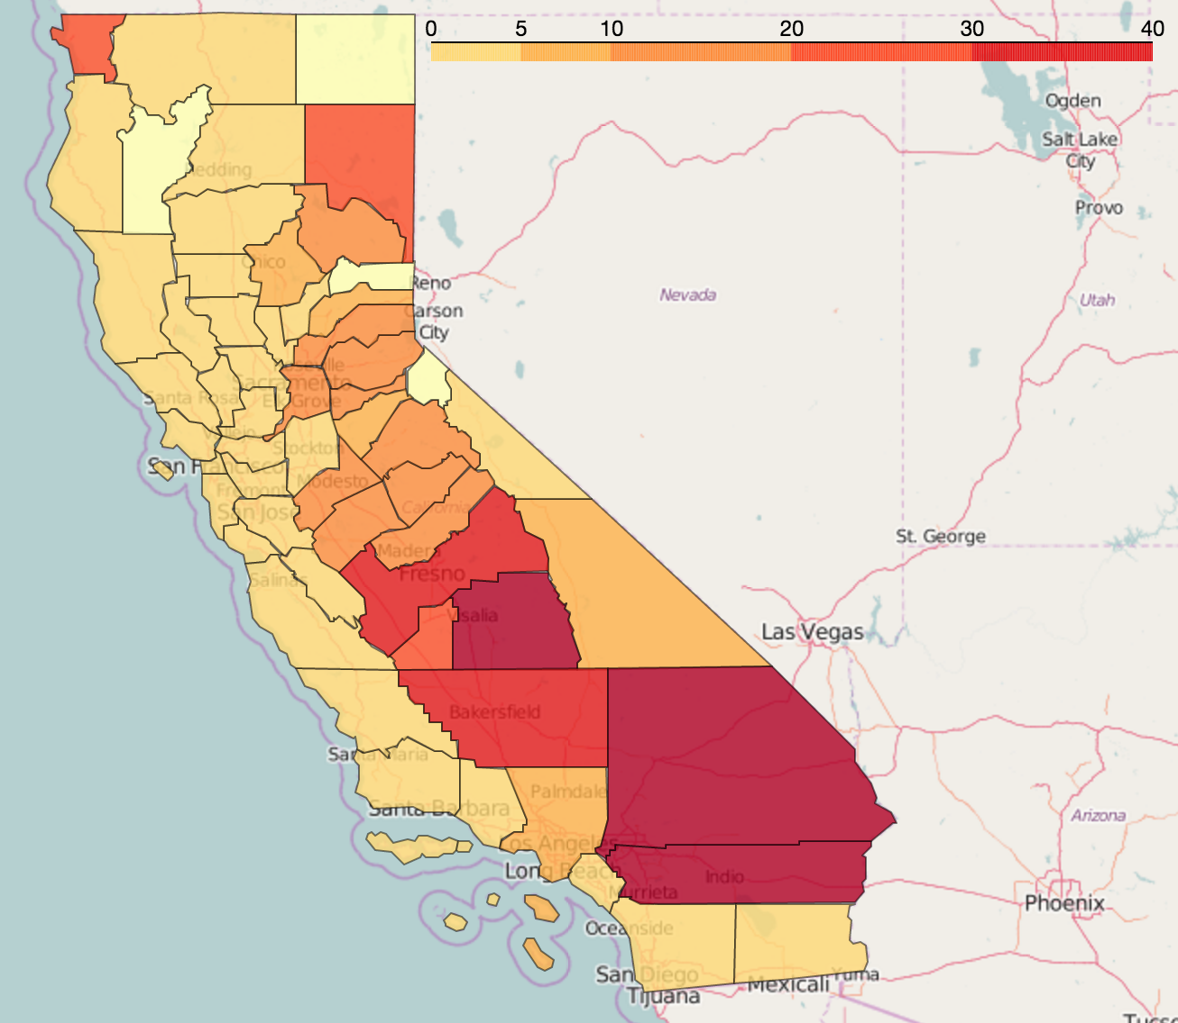
DS-SF-24 Final Project
C. Salviati
Ozone
Home Value
Rental Price

Slide 20
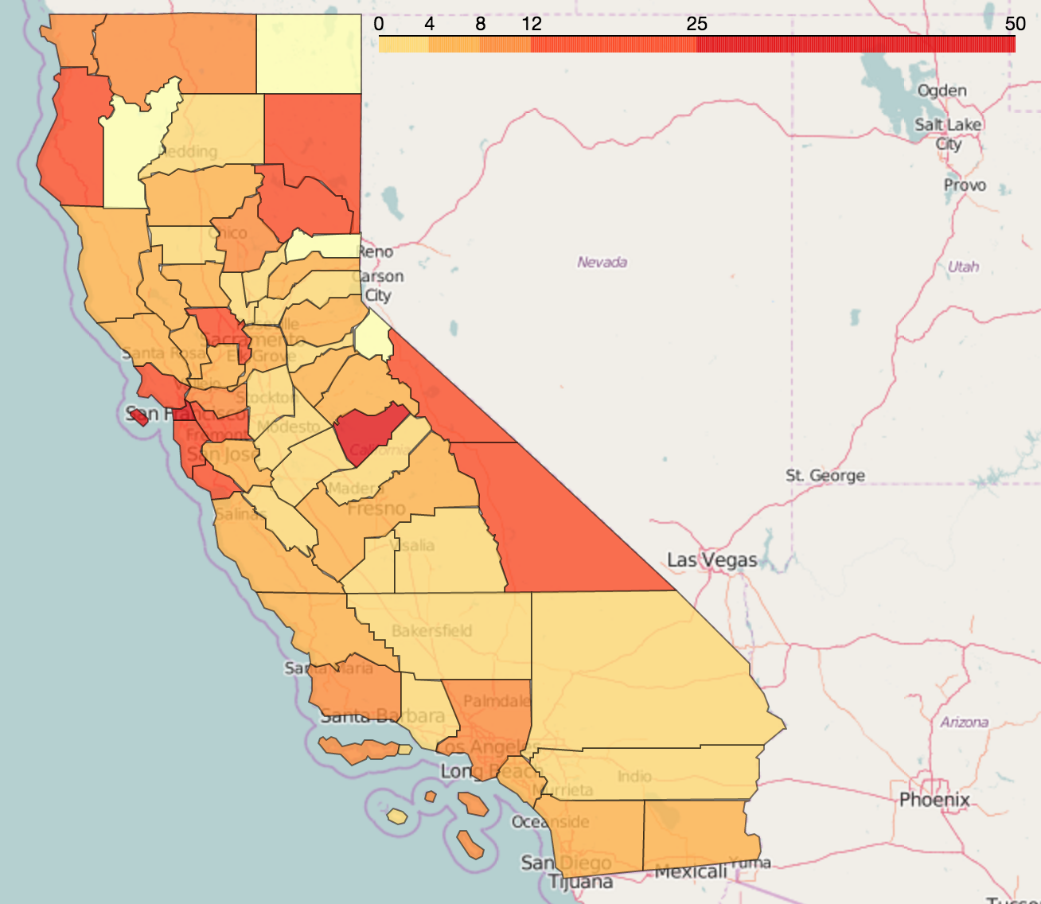
DS-SF-24 Final Project
C. Salviati
Walkability
Home Value
Rental Price

Slide 21
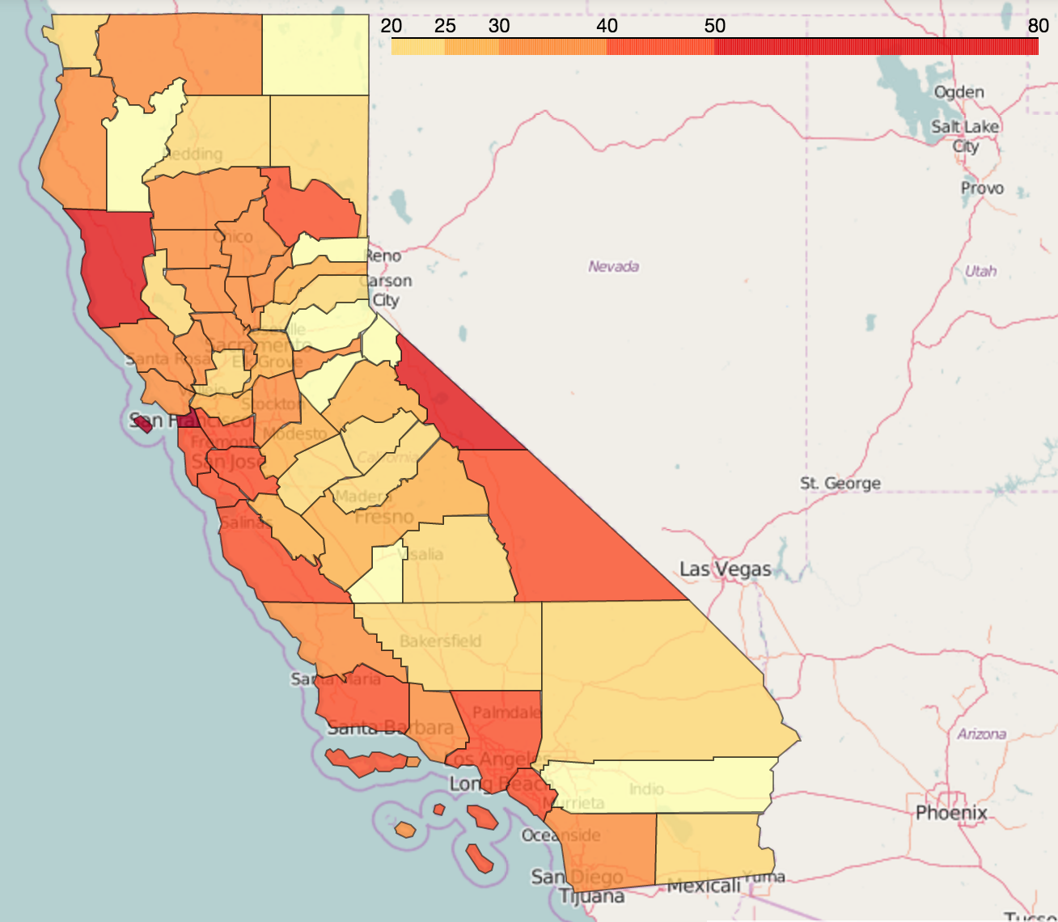
DS-SF-24 Final Project
C. Salviati
Bars/Restaurants
Home Value
Rental Price

Slide 22
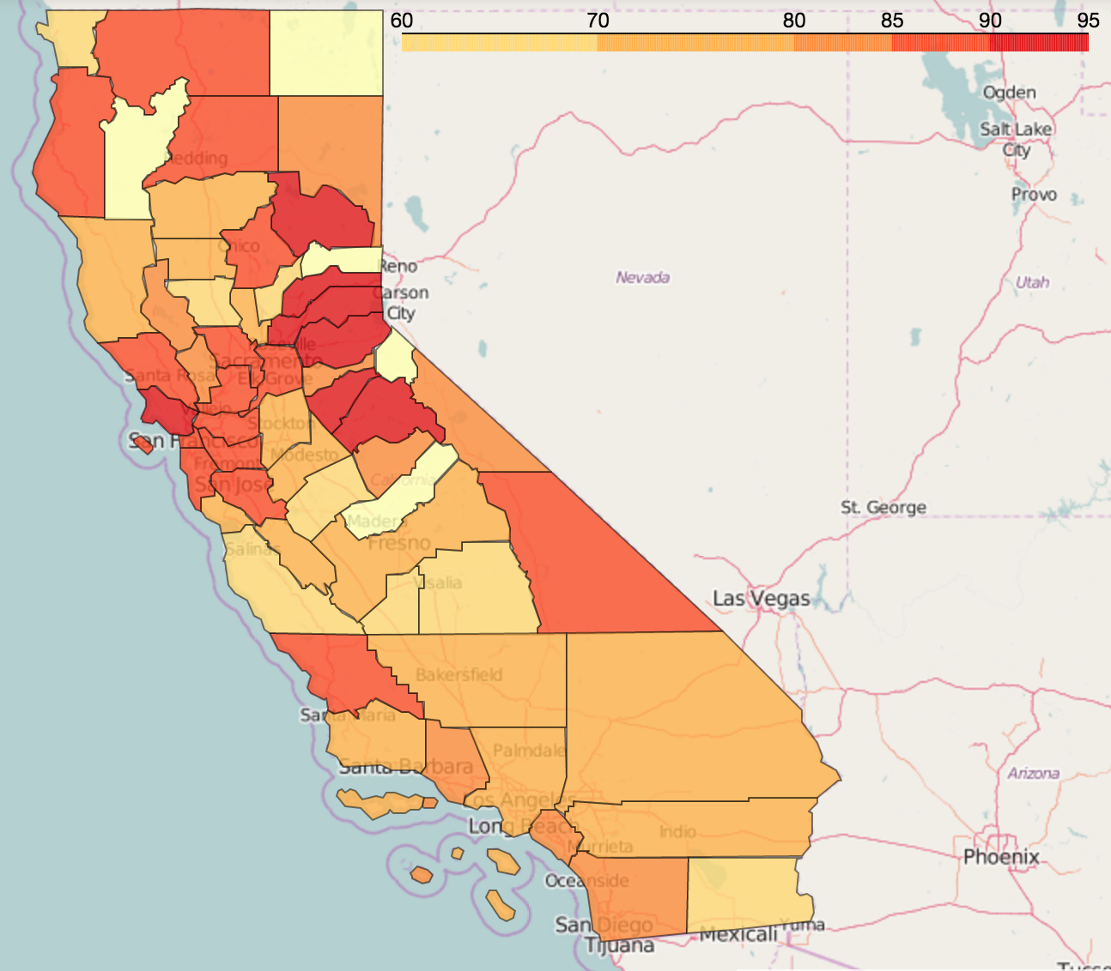
DS-SF-24 Final Project
C. Salviati
Percent HS Grads
Home Value
Rental Price

Slide 23
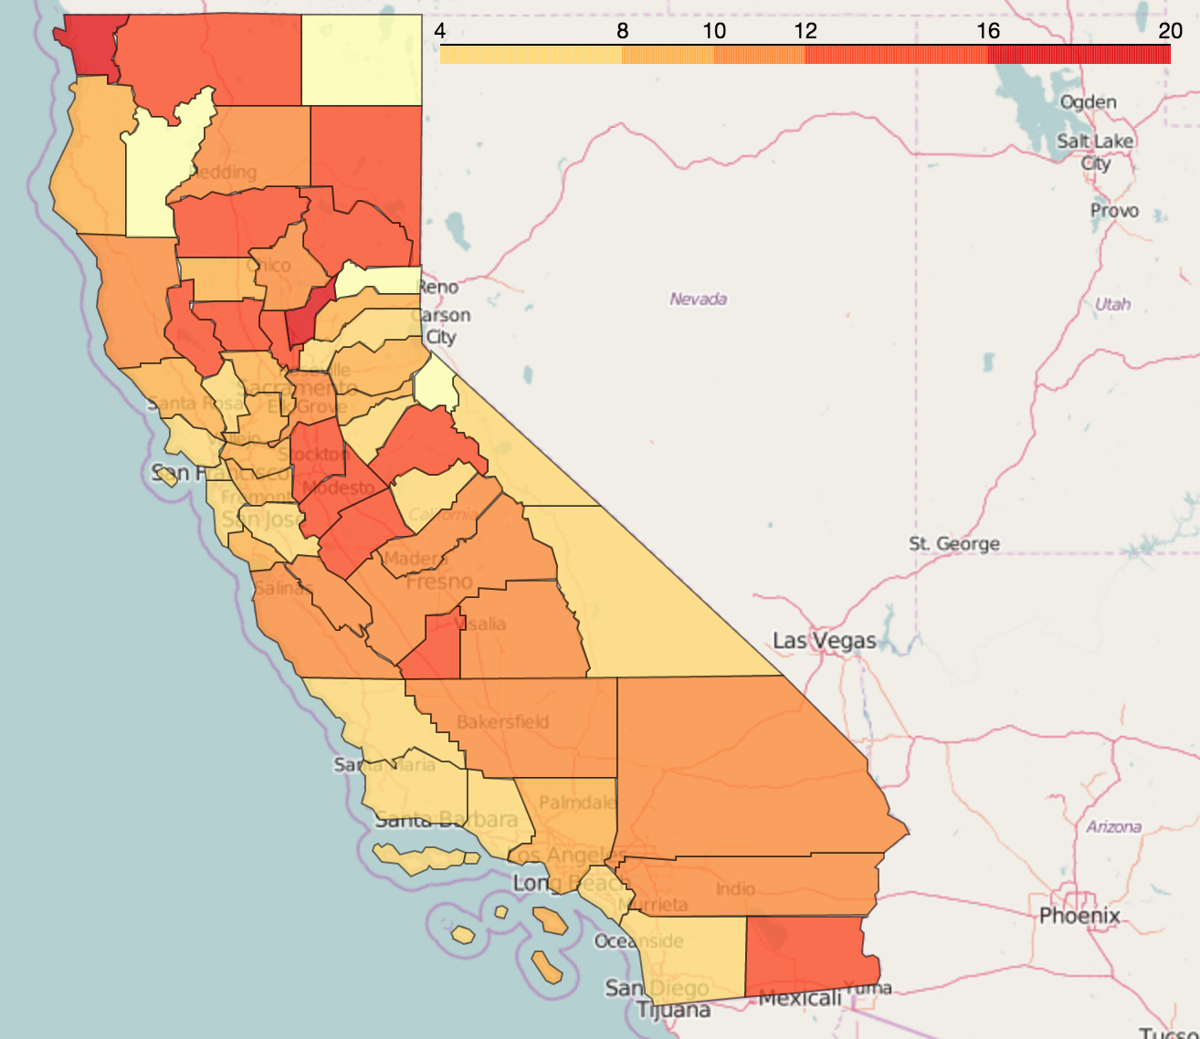
DS-SF-24 Final Project
C. Salviati
Unemployment Rate
Home Value
Rental Price

Slide 24
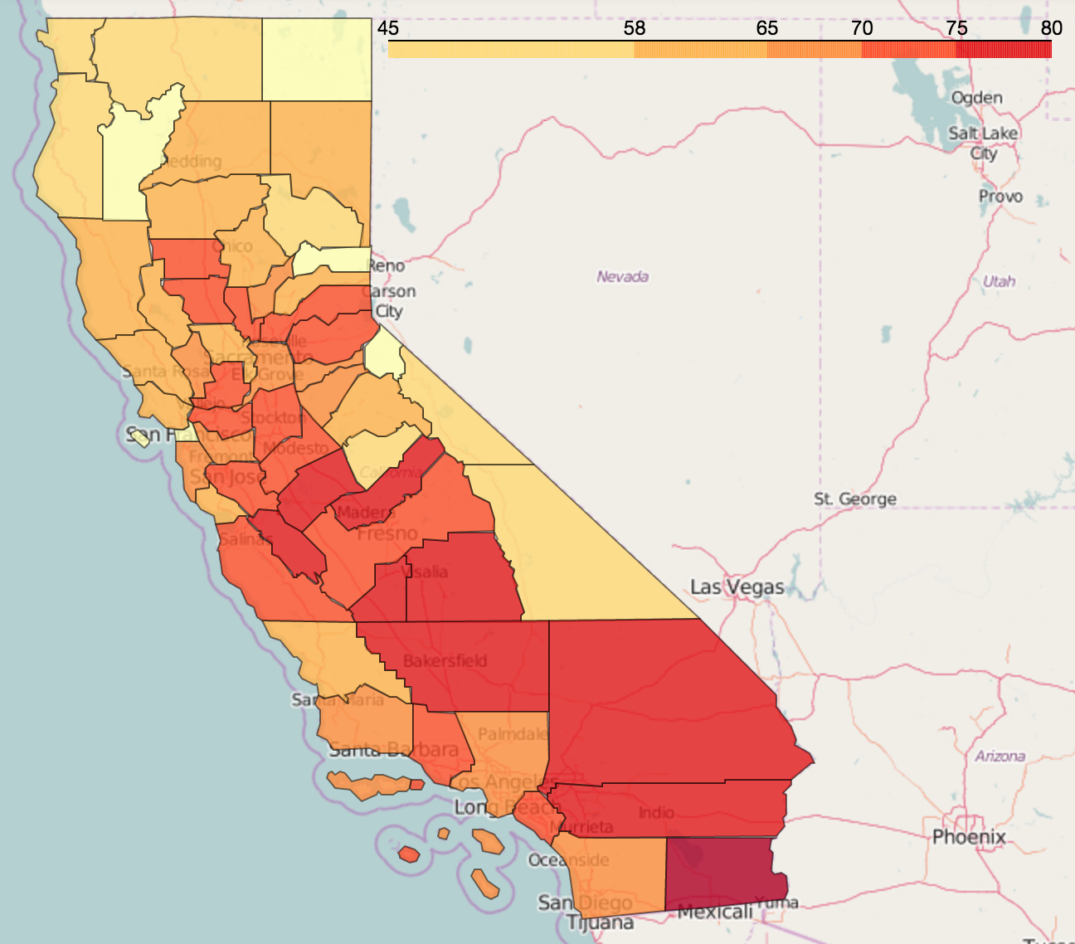
DS-SF-24 Final Project
C. Salviati
Percent Families
Home Value
Rental Price

Slide 25
DS-SF-24 Final Project
C. Salviati
Thanks.

